Slide 1









Using AWS Services
PRESENTED BY
Sanyam Atrey
Real-Time
Ride Booking
System
Fully Serverless and Event Driven architecture

Slide 2

About
My project is a Real-Time Ride Booking System using AWS serverless architecture. When a user books a ride, the system assigns a driver automatically, stores data in a database, and sends a real-time notification.

Slide 3

Services Used
Lambda → backend logic
API Gateway → request handling
Dynamo DB → store rides & drivers
SNS → send notifications

Slide 4





Architecture
USER
User sends Request
This is an event-driven serverless architecture.
API gateway
API gateways trigger lambda
AWS lambda
Lambda assigns driver
Dynamo DB
stores data in DynamoDB
Amazon SNS
SNS sends notification

Slide 5

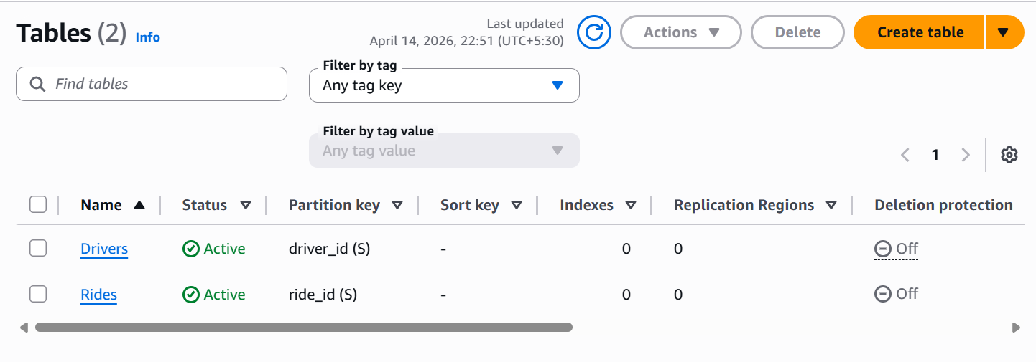
Dynamo DB
Tables

Slide 6
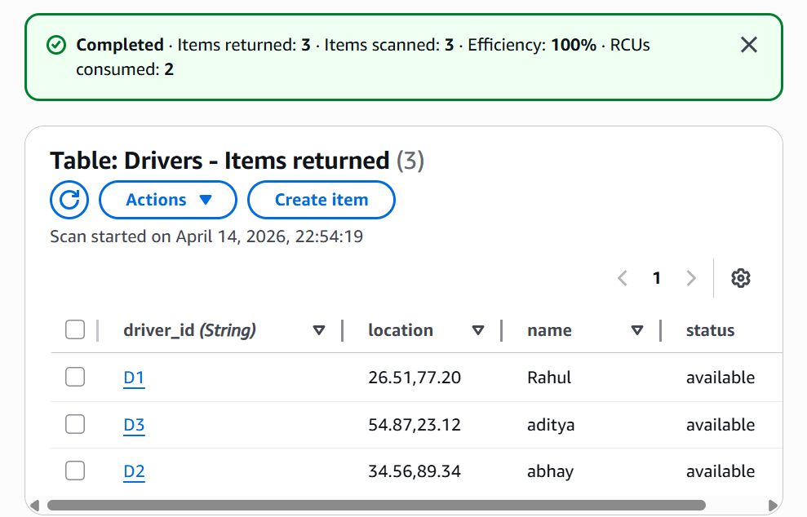
Table
Items

Slide 7
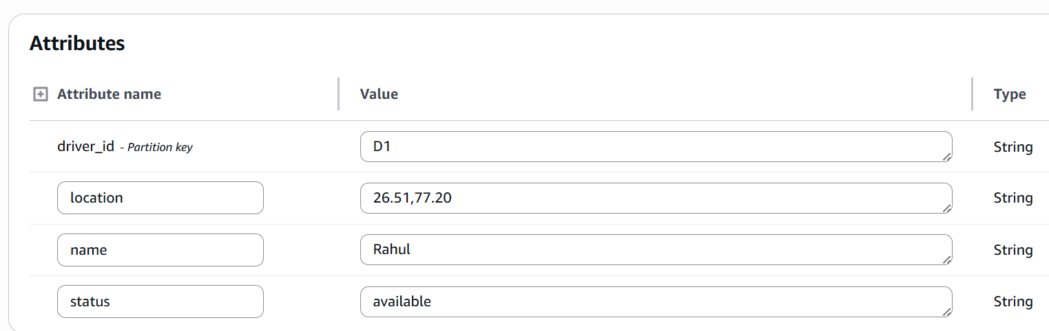
Items
Attributes

Slide 8

Lambda Function

Slide 9
Amazon SNS

Slide 10
Conclusion
This Project demonstrates a fully serverless,
event driven architecture using
AWS cloud Services.
→ Real backend system
→ Real AWS service
→ Realtime Workflow
→ Working Notification System

Slide 11
Thank you
PRESENTED BY
Sanyam Atrey

